Slide 1
Non Journal Media Study Data and MARS Reports*
*Available to MARS users who license Non Journal Media data

Slide 2
Two reports are available for you to analyze Non Journal Media
1) NJM Ranking Report Evaluate NJM against each other
2) Multimedia Ranking Report Evaluate NJM against each other and against journals/tabloids

Slide 3
Metrics Collected for Non Journal Media
Users/Total Readers
Annual Uses Per User
Annual Uses
Mean Pages Per Use (Paper Ref Only)
Total Annual Pages Exposed (Paper Ref Only)
Mean Minutes Per Use (For Digital Only)
Total Annual Minutes Exposed (For Digital Only)

Slide 4
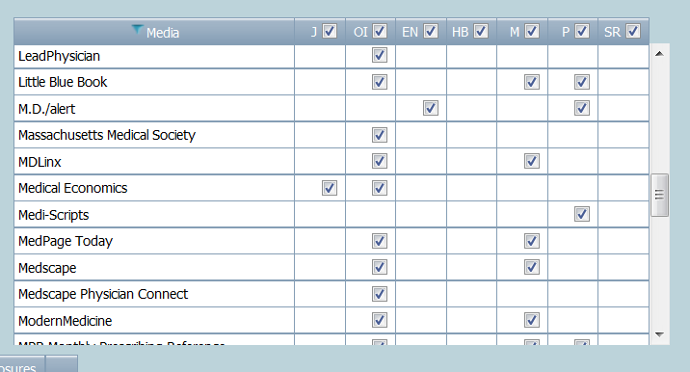
The Non Journal Media appear as an option when you select the Media Group
Each NJM media type available has its own column within the Media Group:
If an NJM was studied for that media type, there will be a check box in the column.
O=Online/Internet
EN=Email/ e-Newsletters HB=Hospital Billboards, M=Mobile
P=Paper
SR=Satellite Radio

Slide 5
Specialties Studied for Non-Journal Media
Medical/Surgical
Multi-specialty
Allergy
Anesthesiology
Cardiology
Dermatology
Diabetes
Emergency Medicine
Gastroenterology
General Surgery
Infectious Disease
Internal Medicine
Nephrology
Neurology
OBGYN
Oncology/Hematology
Orthopedic Surgery
Otolaryngology
Pediatrics
Psychiatry
Pulmonary
Rheumatology
Urology
NPPA
Pharmacy

Slide 6
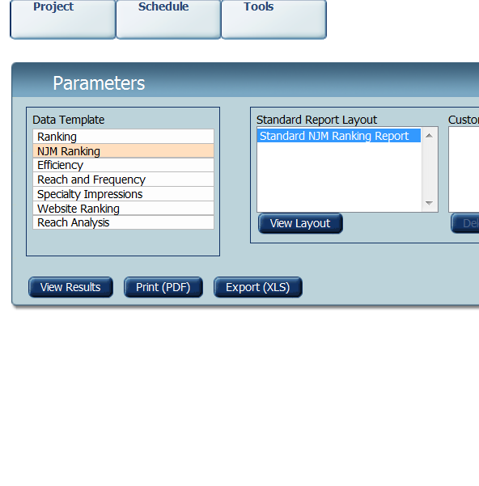
Analysis Ranks for Non Journal Media
From the Parameters screen, choose the Data Template for “NJM Ranking” for comparing NJM. The layout will default to Standard NJM Ranking Report. The report will include the NJM metrics.

Slide 7
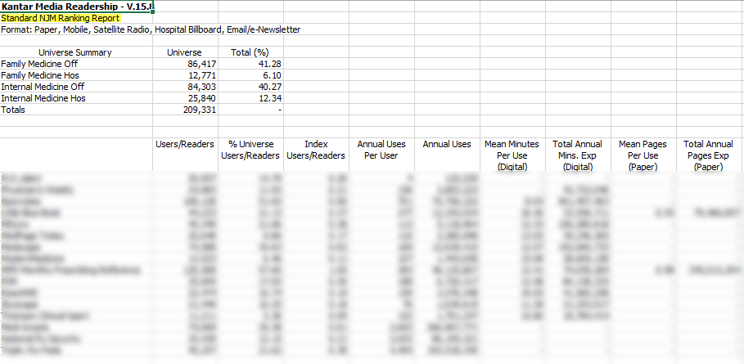
Standard NJM Ranking Report - Example

Slide 8
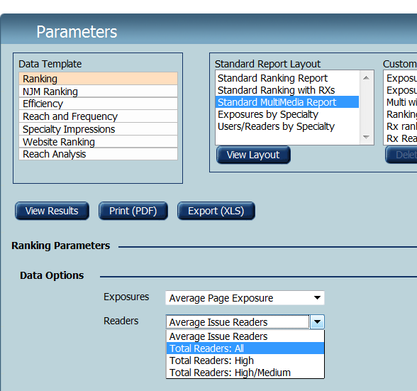
Analysis Ranks for MultiMedia (Journal and NJM)
From the Parameters screen, choose the Data Template for “Ranking ” and the “Standard MultiMedia Report” layout together. The report will include both Journal and NJM metrics.
The common metric for journal media and non journal media is Readers/Users. Select “Total Readers-All” only. (Exposures can default to whatever is on the screen as they are not included in this report.)

Slide 9
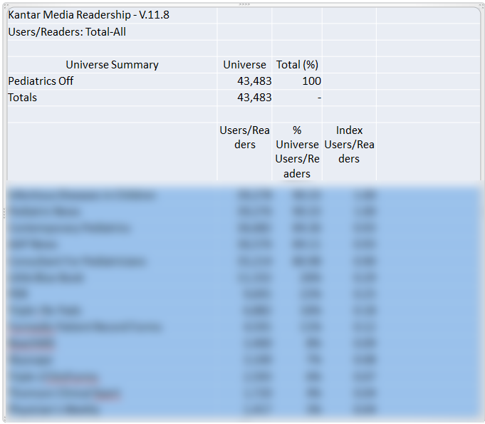
Standard Multimedia Ranking - Example

